Slide 1
“Trauma and Substance Use:
Making Sense of What Doesn’t Make Sense:
Age of First Use and Trauma as Risk Factors”
Missouri Coordinated School Health Coalition
State Conference
March 15
2025
Lodge of the Four Seasons
Heather Harlan
Columbia Boone County Public Health and Human Services
Health Program Coordinator
CRPS, MAADC II (Certified Reciprocal Prevention Specialist, Missouri Associate Drug and Alcohol Counselor II)

Slide 3
Objectives
Understand how substance use
disorders (SUD or addictions) are
chronic brain diseases and how they
develop.
Discover the ways age and trauma create higher vulnerability to alcohol tobacco and other drugs and for developing a SUD.
Learn at least 2 evidence based strategies to enhance primary prevention.

Slide 4
Objectives
Understand how substance use
disorders (SUD or addictions) are
chronic brain diseases and how they
develop.
Discover the ways age and trauma create higher vulnerability to alcohol, tobacco and other drugs and for developing a SUD.
Learn at least 2 evidence based strategies to enhance primary prevention.

Slide 5
Objectives
Understand how substance use
disorders (SUD or addictions) are
chronic brain diseases and how they
develop.
Discover the ways age and trauma create higher vulnerability to alcohol, tobacco and other drugs and for developing a SUD.
Recognize at least 2 evidence based strategies to enhance primary prevention.

Slide 6
?
Why do they do that?
Me
Notes:
I could describe SUD behavior.
How many people in here can?
But I couldn’t really understand what was going on in the brain.
So I started looking.

Slide 7
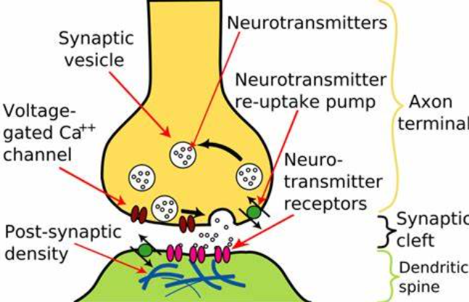
Notes:
I had a loved one who for whom alcohol seemed to be causing a problem.
I tried to understand. Watched videos, read articles, etc.

Slide 9
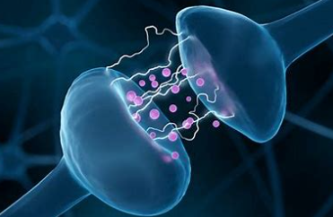

Slide 10
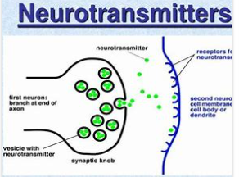

Slide 11
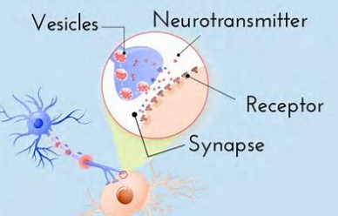

Slide 12
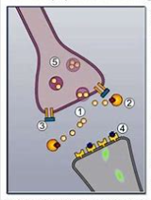

Slide 13
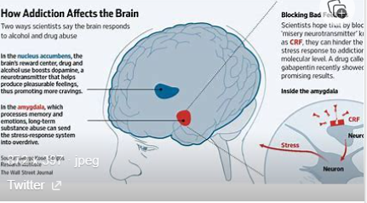

Slide 14
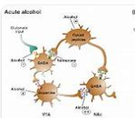

Slide 15
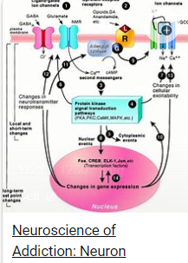

Slide 17
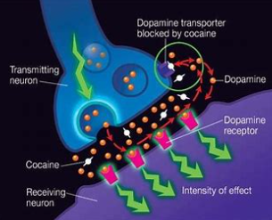

Slide 18
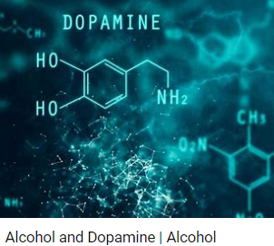

Slide 19
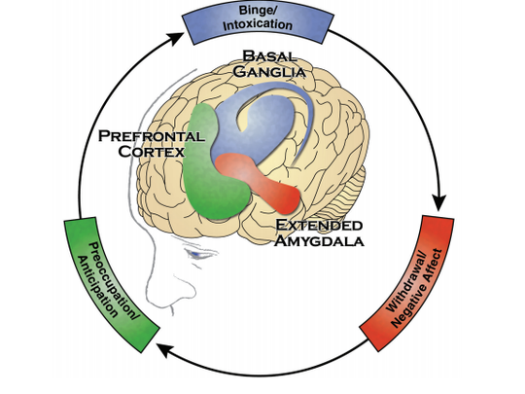

Slide 20
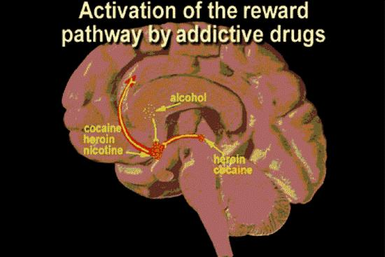

Slide 21
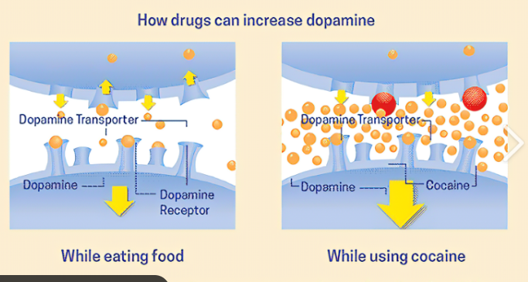

Slide 22
?
Why do they do that?
StillMe
Notes:
I could describe SUD behavior.
How many people in here can?
But I couldn’t really understand what was going on in the brain.
So I started looking.

Slide 23
1.Why younger age increases risk.
Notes:
None of these scientific illustrations and explanations helped me understand substance use disorders. Turns out, wasn’t alone.
I couldn’t begin to understand why my l loved one was drinking themselves to death. So I began a search to be able to find a way to explain it to myself that made sense.
Metaphors—compare to something we do understand. “Tastes like chicken.”

Slide 24
Three details about all our brains:
1. Mature at about __ years.
2. Most like hunter/gatherers________
years ago.
3. _____% of SUDs begin during adolescence.

Slide 25
Three details about all our brains:
1. Mature at about 25 years.
2. Most like hunter/gatherers_______
years ago.
3. _____% of SUDs begin during adolescence.

Slide 26
Three details about all our brains:
1. Mature at about 25 years.
2. Most like hunter/gatherers 10,000
years ago.
3. _____% of SUDs begin during adolescence.

Slide 27
Three details about all our brains:
1. Mature at about 25 years.
2. Most like hunter/gatherers 10,000
years ago.
3. 90 % of SUDs begin during adolescence.

Slide 28
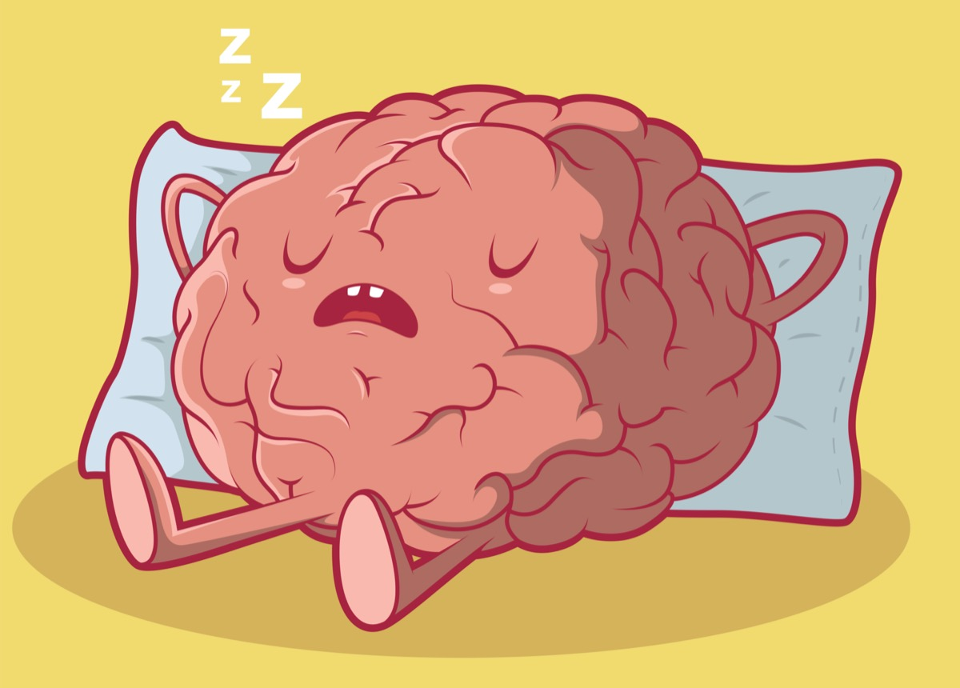
Your brain is
lazy

Slide 29
Other observations
When you try to change your behavior your brain acts like a
Liar
Bully
Whiny child

Slide 30
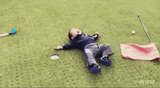
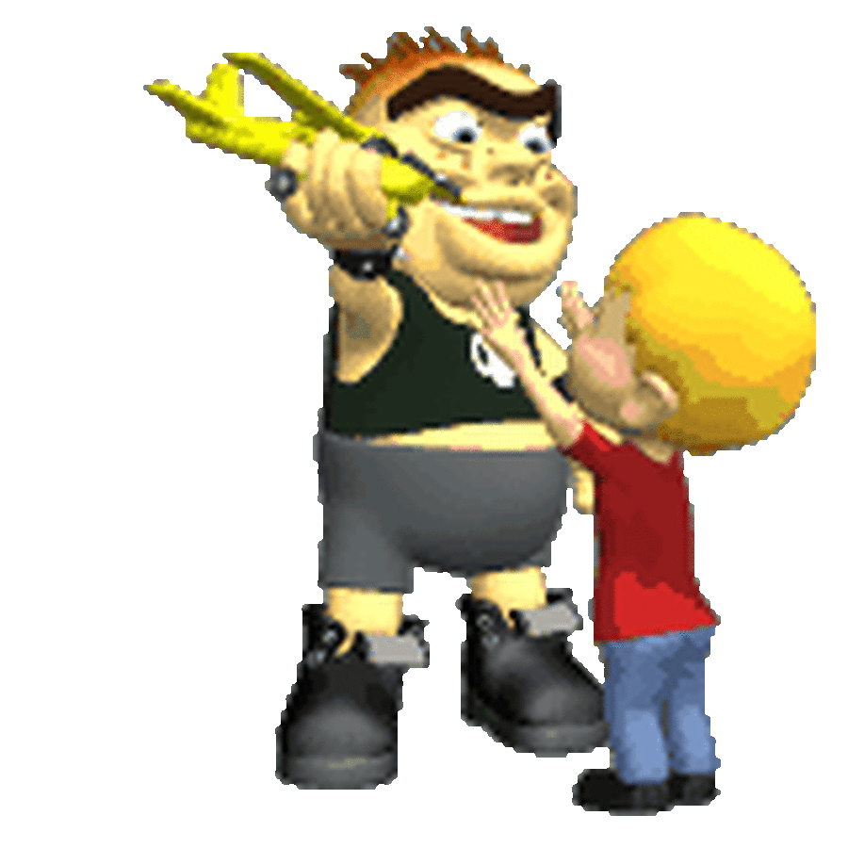

Slide 31
Here’s why . . .

Slide 32
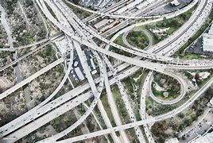
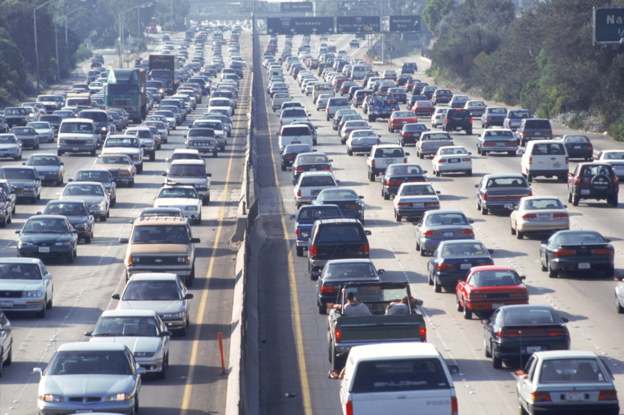
Roads in your
brain
diagram

Slide 33
Another way to understand the brain.
Bean bags,
Dopamine, and
Neuropathways

Slide 34
Lights demonstration

Slide 35
Lights demonstration

Slide 36
Lights demonstration

Slide 37
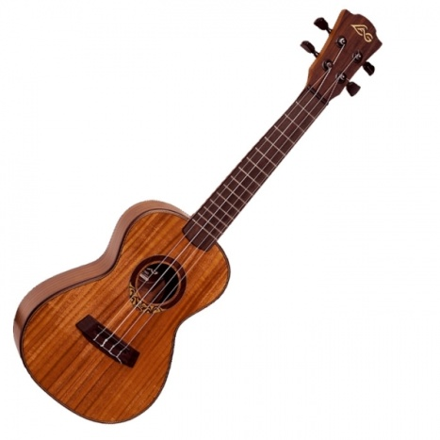
To the tune “If You're Happy & You Know It” PREVENTION
What’s rewarded gets repeated
yes it’s true.
What’s rewarded gets repeated
yes it’s true.
We reinforce and affirm
So our brains can learn.
What’s rewarded gets repeated
yes it’s true.
Tune:
If You’re Happy and You Know It.

Slide 38
To the tune “If You're Happy & You Know It” PREVENTION
What’s rewarded gets repeated
yes it’s true.
What’s rewarded gets repeated
yes it’s true.
But alcohol and drugs and change the neuropathways in our brains.
What’s rewarded gets repeated
yes it’s true.

Slide 39
To the tune “If You're Happy & You Know It” PREVENTION
What’s rewarded gets repeated
yes it’s true.
What’s rewarded gets repeated
yes it’s true.
We reinforce and affirm
So our brains can learn.
What’s rewarded gets repeated
yes it’s true.
Recovery!

Slide 40
Age of first use matters— Pediatric Onset disease
Use of alcohol, tobacco or other drugs
Before age 18
1 in 4 chance of developing a SUD (addiction)

Slide 41
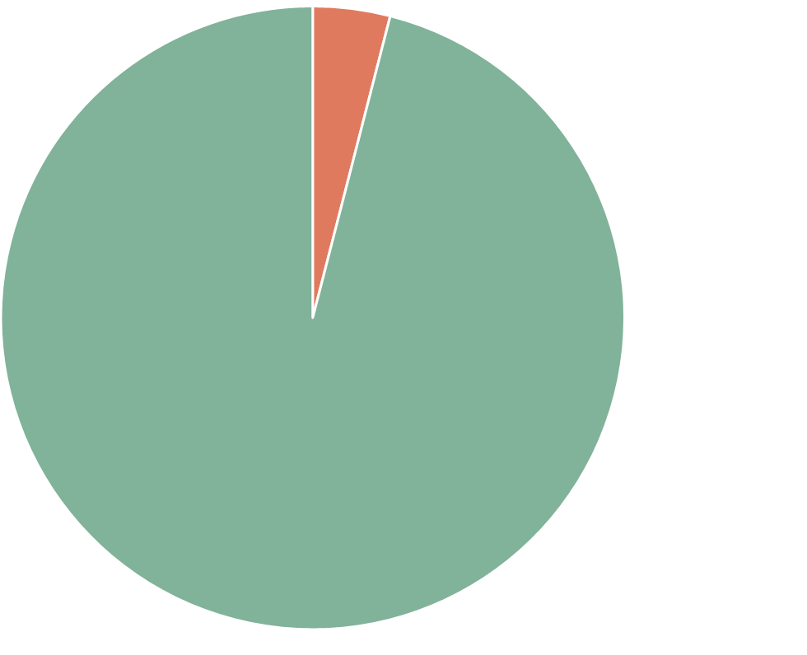
Age of first use matters— Pediatric Onset disease
Use of alcohol, tobacco or other drugs
Before age 18
1 in 4 chance of developing a SUD (addiction)
Use of alcohol, tobacco or other drugs
After age 21.
1 in 25 chance of
developing a SUD
(addiction).
National Center on Addiction and Substance Abuse, Columbia University

Slide 42
Now, let’s discover together .
how. .

Slide 43
2. Why TRAUMA increases risk.

Slide 44
Adverse Childhood Experiences
ACEs

Slide 45
One point for every question you answer “yes.”
Your ACE Score

Slide 46
Prior to you 18th birthday
1.Did a parent or other adult in the household often or very often… Swear at you, insult you, put you down, or humiliate you? or Act in a way that made you afraid that you might be physically hurt?
2. Did a parent or other adult in the household often or very often push, grab, slap, or throw something at you? or ever hit you so hard that you had marks or were injured?
Adverse
Childhood
Experiences
ACEs-baseline
in 1995 study

Slide 47
Prior to you 18th birthday
1.Did a parent or other adult in the household often or very often… Swear at you, insult you, put you down, or humiliate you? or Act in a way that made you afraid that you might be physically hurt?
2. Did a parent or other adult in the household often or very often push, grab, slap, or throw something at you? or ever hit you so hard that you had marks or were injured?
Adverse
Childhood
Experiences
ACEs-baseline
in 1995 study

Slide 48
Prior to you 18th birthday
3. Did an adult or person at least 5 years older than you ever… Touch or fondle you or have you touch their body in a sexual way? or Attempt or actually have oral, anal, or vaginal intercourse with you?
4. Did you often or very often feel that … No one in your family loved you or thought you were important or special? or Your family didn’t look out for each other, feel close to each other, or support each other?
Adverse
Childhood
Experiences
ACEs-baseline
in 1995 study

Slide 49
Prior to you 18th birthday
3. Did an adult or person at least 5 years older than you ever… Touch or fondle you or have you touch their body in a sexual way? or Attempt or actually have oral, anal, or vaginal intercourse with you?
4. Did you often or very often feel that … No one in your family loved you or thought you were important or special? or Your family didn’t look out for each other, feel close to each other, or support each other?
Adverse
Childhood
Experiences
ACEs-baseline
in 1995 study

Slide 50
Prior to you 18th birthday
5. Did you often or very often feel that … You didn’t have enough to eat, had to wear dirty clothes, and had no one to protect you? or Your parents were too drunk or high to take care of you or take you to the doctor if you needed it?
6. Were your parents ever separated or divorced?
Adverse
Childhood
Experiences
ACEs-baseline
in 1995 study

Slide 51
Prior to you 18th birthday
5. Did you often or very often feel that … You didn’t have enough to eat, had to wear dirty clothes, and had no one to protect you? or Your parents were too drunk or high to take care of you or take you to the doctor if you needed it?
6. Were your parents ever separated or divorced?
Adverse
Childhood
Experiences
ACEs-baseline
in 1995 study

Slide 52
Prior to you 18th birthday
7. Was your mother or stepmother: Often or very often pushed, grabbed, slapped, or had something thrown at her? or Sometimes, often, or very often kicked, bitten, hit with a fist, or hit with something hard? or Ever repeatedly hit over at least a few minutes or threatened with a gun or knife?
8. Did you live with anyone who was a problem drinker or alcoholic, or who used street drugs?
Adverse
Childhood
Experiences
ACEs-baseline
in 1995 study

Slide 53
Prior to you 18th birthday
7. Was your mother or stepmother: Often or very often pushed, grabbed, slapped, or had something thrown at her? or Sometimes, often, or very often kicked, bitten, hit with a fist, or hit with something hard? or Ever repeatedly hit over at least a few minutes or threatened with a gun or knife?
8. Did you live with anyone who was a problem drinker or alcoholic, or who used street drugs?
Adverse
Childhood
Experiences
ACEs-baseline
in 1995 study

Slide 54
Prior to you 18th birthday
9. Was a household member depressed or mentally ill, or did a household member attempt suicide?
10. Did a household member go to prison?
Adverse
Childhood
Experiences
ACEs-baseline
in 1995 study

Slide 55
Prior to you 18th birthday
9. Was a household member depressed or mentally ill, or did a household member attempt suicide?
10. Did a household member go to prison?
Adverse
Childhood
Experiences
ACEs-baseline
in 1995 study

Slide 56
For every “yes” you answered, you get one point:
THAT is your ACE score.

Slide 57
Stress to young brain higher levels of cortisone.

Slide 58
In short . . .
People (students)
who have higher ACE scores
are physiologically different
than people who have 0 or
very low ACE scores.

Slide 59
Notes:
How about in this group? How can you know who is at higher risk?

Slide 60
Notes:
Let’s say you think it will be safer to “teach” your teen to drink at home?
Which one of your child’s friends will be more vulnerable because of adverse childhood experiences? Can you tell?

Slide 61
Youth substance use up?

Slide 62
Ever hear or think this?

Slide 63
Let’s update folks!
More and more kids are using drugs these days.
Actually, that’s not true!

Slide 64
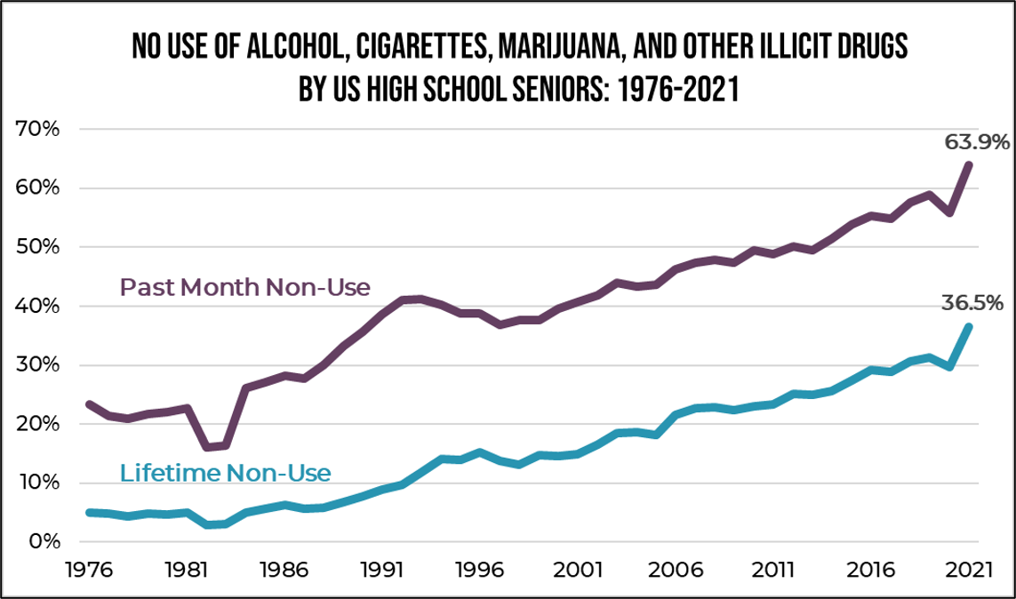
Source:
One Choice
Prevention
Data from
Monitoring the Future
School Surveys

Slide 65
What year were YOU a senior?
Source:
One Choice
Prevention
Data from
Monitoring the Future
School Surveys
Consider your own high school experience. Contrast those figures to today's teens, many of whom are not using any substances

Slide 66
3) How YOU can help PREVENT?
Here’s what works:
Increasing the price (Big $$$ in creating disease, $0 in prevention)
Policies that limit access for underage youth, DELAY AGE OF FIRST USE.
example Tobacco 21, Alcohol carding
Funding for enforcement of policies

Slide 67
How YOU can help PREVENT?
Here’s what works:
Placement—where is placed by merchants?
Limit advertising to youth
(colors, candy flavors, etc.)
Perception of harm—how we model use and speak of it.

Slide 68
How YOU can help PREVENT?
Here’s what works:
Please STOP referring to Prohibition, “Just Say No” or
“D.AR.E” as prevention
40-100 year-old ideas.
Treatment has changed.
So has prevention.
FIRST!

Slide 69
Missouri Student Survey
Promote MSS
The Missouri Student Survey (MSS)
conducted in even-numbered years
tracks risk behaviors of students
grades 6-12 attending public schools in Missouri
participation in the survey is completely optional.

Slide 70
To treat a patient

Slide 71
Missouri Student Survey
Promote MSS
The Missouri Student Survey (MSS)
includes questions on
alcohol, tobacco, and drug use and
other behaviors that endanger health and safety.

Slide 72
Missouri Student Survey
County Level
data .
Compares to past county data and national data.
Internet Search for
“Missouri Student Survey”

Slide 73
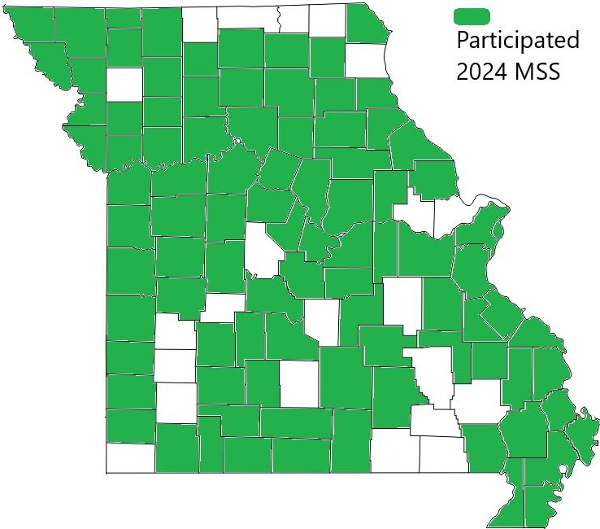
Did YOUR county participate?

Slide 74
1:45 – 2:45 TODAY at the conference
“Evidence-Based Practices Regarding
How to Prepare and Respond to an
Opioid Emergency in Your School”
2:00 P.M. today
Dave Zellmer, MPH, Columbia/Boone County Public Health and Human Services;
Alec Mundle, CHES, MPH, Columbia/Boone County Public Health and Human Services

Slide 75
Final Quiz:
1. Mature at about __ years.
2. Most like hunter/gatherers________
years ago.
3. _____% of SUDs begin during adolescence.

Slide 76
Final Quiz:
1. Mature at about 25 years.
2. Most like hunter/gatherers_______
years ago.
3. _____% of SUDs begin during adolescence.

Slide 77
Final Quiz:
1. Mature at about 25 years.
2. Most like hunter/gatherers 10,000
years ago.
3. _____% of SUDs begin during adolescence.

Slide 78
Final Quiz:
1. Mature at about 25 years.
2. Most like hunter/gatherers 10,000
years ago.
3. 90 % of SUDs begin during adolescence.

Slide 79
Final Quiz:
Basically your brain is

Slide 80
Final Quiz:
lazy

Slide 81
Final Quiz
Age of _______matters.
What’s rewarded gets ________.
ACEs refers to Adverse _________________________________.
Students with higher ACEs are _____________different and more at risk.

Slide 82
Final Quiz
Age of first use matters.
What’s rewarded gets ________.
ACEs refers to Adverse _________________________________.
Students with higher ACEs are _____________different and more at risk.

Slide 83
Final Quiz
Age of first use matters.
What’s rewarded gets repeated.
ACEs refers to Adverse _________________________________.
Students with higher ACEs are _____________different and more at risk.

Slide 84
Final Quiz
Age of first use matters.
What’s rewarded gets repeated.
ACEs refers to Adverse
Childhood Experiences.
Students with higher ACEs are _____________different and more at risk.

Slide 85
Final Quiz
Age of first use matters.
What’s rewarded gets repeated.
ACEs refers to Adverse
Childhood Experiences.
Students with higher ACEs are physiologically different and more at risk.

Slide 86
Final Quiz
One evidence-based way to help reduce youth substance use is to raise ______.
Another way is to limit advertising addictive substances to _____.
Your school can make primary prevention more effective if your school participates in the
______________________________

Slide 87
Final Quiz
One evidence-based way to help reduce youth substance use is to raise prices.
Another way is to limit advertising addictive substances to _____.
Your school can make primary prevention more effective if your school participates in the
______________________________

Slide 88
Final Quiz
One evidence-based way to help reduce youth substance use is to raise prices.
Another way is to limit advertising addictive substances to youth.
Your school can make primary prevention more effective if your school participates in the
______________________________

Slide 89
Final Quiz
One evidence-based way to help reduce youth substance use is to raise prices.
Another way is to limit advertising addictive substances to youth.
Your school can make primary prevention more effective if your school participates in the
____Missouri Student Survey_______.

Slide 90
Remember! 2:00 PM TODAY!
?

Slide 91
Remember! 2:00 PM TODAY!

Slide 92
You’re the BEST!

Slide 93
What questions do you have for me today?

Slide 94
Contact
Heather Harlan 573-817-6404 Heather.Harlan@Como.Gov

